Slide 1
Machine Learning 机器学习 Week# 02
Dr. Awais Ahmed

Slide 2
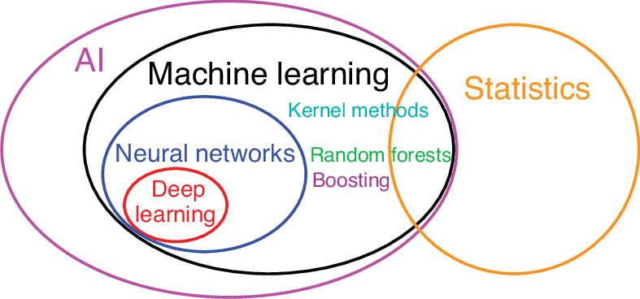

Slide 3
教学进度 |  |  |  | 教学内容 | 备注
月 | 日 | 周次 | 教学时数
9 | 16 | 02 | 3 | Introduction to Machine Learning Overall Course Content Discussion & Organization Introduction to the types of Artificial Intelligence | Course setup
9 | 23 | 03 | 3 | An introduction to linear regression, covering linear models, loss, gradient descent, and hyperparameter tuning. | Case study: house price prediction
9 | 30 | 04 | 3 | An introduction to logistic regression, where ML models are designed to predict the probability of a given outcome.
10 | 07 | 05 | 3 | An introduction to binary classification models, covering thresholding, confusion matrices, and metrics like accuracy, precision, recall, and AUC. Test – 1 Lab Session 9th Oct 2025
10 | 14 | 06 | 3 | Working with Numerical Data, Working with Categorical Data, Datasets, Generalization, and Overfitting Lab Session 16th Oct 2025
10 | 21 | 07 | 3 | Heading towards classification: Decision Forests (Minimum both algorithm detailed understanding Decision Tree, Random Forest) Lab Session 22nd Oct 2025 | Algorithm understanding and dry run
10 | 28 | 08 | 3 | Heading towards clustering: k-Means (if time permits bagging and boosting) Lab Session 28th Oct 2025
11 | 04 | 09 | 3 | Example Project Demonstration and Students’ Project Discussion (Implementation and report with Viva) or Prepare and submit Conference Paper (if accepted it’s much better)
11 | 11 | 10 | 3 | Image Classification Lab Session 16th Oct 2025 (last four sessions all together)
11 | 18 | 11 | 3 | Test - 2 Neural Networks Introduction: perceptron, activation functions, hidden layers Embeddings & Intro to LLMs: dense vector representations, word embeddings, transformer basics Course Recap
11 | 25 | 12 | 3 |  | Transition to advance discussion

Slide 4
What is Artificial Intelligence?
Should we talk ML first or AI?
What do you know about it, let’s discuss?

Slide 5
What is ML?
Should we talk AI first or ML?
What do you know about it, let’s discuss?

Slide 6
Let’s define one by one 1/3
Artificial Intelligence (AI) is the broadest domain, representing systems or machines designed to mimic human intelligence, including reasoning, problem-solving, learning, and decision-making. AI includes rule-based systems, expert systems, natural language processing, robotics, and more.

Slide 7
Let’s define one by one 2/3
Machine Learning (ML) is a subset of AI focused on algorithms and statistical models that allow machines to improve at tasks through experience (data) without being explicitly programmed for every task. ML uses patterns and inference to enable automation in decision-making.

Slide 8
Let’s define one by one 3/3
Deep Learning (DL) is a further specialized subset within ML, employing artificial neural networks with multiple layers (hence “deep”) to model complex patterns in large-scale data. DL excels at tasks like image recognition, speech processing, and natural language understanding, often requiring huge datasets and computational power.

Slide 9
How someone master it?
The simple answer is anyone with the following:
Mathematics
Statistics
Motivation
Programming (at-least mid level understanding)

Slide 10
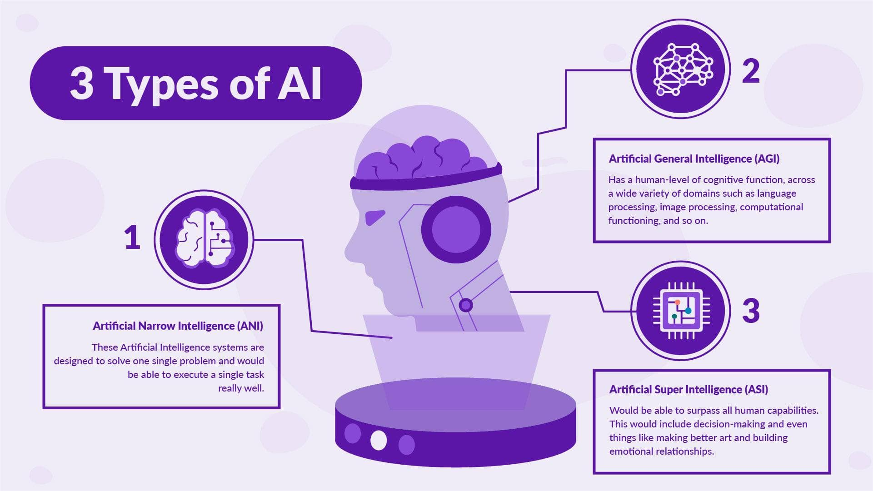

Slide 11
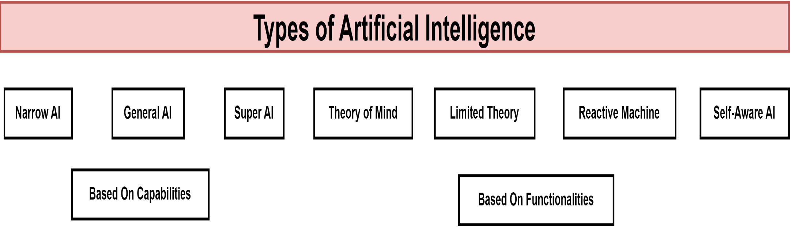

Slide 12
Types of AI Based on Capabilities
Artificial Narrow Intelligence (ANI) or Weak AI:
This is the only type of AI that exists today. ANI systems specialize in performing specific tasks and excel in those predefined activities but cannot operate outside their designed scope. Examples include virtual assistants like Siri and Alexa, recommendation systems like Netflix, and email spam filters. ANI systems use machine learning and deep learning but lack true understanding or general reasoning ability.

Slide 13
Types of AI Based on Capabilities
Artificial General Intelligence (AGI) or Strong AI:
AGI refers to AI systems with generalized human-level intelligence capable of understanding, learning, and applying knowledge across diverse tasks similarly to a human. This type remains theoretical and is under active research. AGI would be adaptable, capable of performing intellectual tasks in completely new contexts without human intervention.

Slide 14
Types of AI Based on Capabilities
Artificial Superintelligence (ASI) or Super AI:
Super AI surpasses human intelligence across all domains, including creativity, decision-making, and emotional intelligence. This is a hypothetical future form of AI that could independently innovate and solve complex global challenges, but it also raises serious ethical and safety concerns

Slide 15
Types of AI Based on Functionalities
Reactive Machines:
These AI systems do not store memories or past experiences and react solely based on current inputs. They are designed for specific tasks with no learning ability. IBM’s Deep Blue chess computer is a classic example. Reactive machines handle repetitive, rule-based functions such as spam filtering and recommendation engines.

Slide 16
Types of AI Based on Functionalities
Limited Memory AI:
Limited Memory AI can use past data and experiences to inform decisions and improve over time, though memory is short-term and task-specific. This kind powers most modern applications like self-driving cars, chatbots, and virtual assistants, which use past user interactions to adapt responses.

Slide 17
Types of AI Based on Functionalities
Theory of Mind AI:
This is a conceptual type of AI under development, which would understand human emotions, beliefs, intentions, and social interactions. Theory of Mind AI aims to simulate human-like empathy and adjust its behavior based on emotional and contextual cues, enabling more natural and personalized interactions.

Slide 18
Types of AI Based on Functionalities
Self-Aware AI:
The most advanced and hypothetical form, Self-Aware AI would possess consciousness, self-awareness, and emotions. It would understand its own internal state and human emotions deeply, potentially having its own needs and beliefs. This type remains speculative and raises philosophical and ethical questions

Slide 19
Where ML comes?
Might be you are thinking 💭 ML comes under functionalities, right? 🤔

Slide 20
Types of AI Based on Technology and Learning
ML enables AI systems to learn patterns from data without explicit programming, improving performance with experience. It includes supervised, unsupervised, and reinforcement learning.
DL a subset of ML using artificial neural networks with multiple layers, allowing AI to analyze complex data like images, sounds, or text for tasks like speech recognition or autonomous driving

Slide 21
Types of AI Based on Technology and Learning
GenAI, these models create new content—text, images, videos—based on learned patterns. Examples include GPT-4 and DALL-E, which generate realistic human-like language or images .
Computer Vision:
AI technology that enables machines to interpret visual inputs, useful in facial recognition, object detection, medical imaging, and autonomous navigation
Robotics:
Combines AI with robotics to automate physical tasks, including industrial robots, medical assistants, and autonomous vehicles

Slide 22
Summary
Currently, Artificial Narrow Intelligence (ANI) dominates applications, excelling in narrow domains but lacking general reasoning.
Artificial General Intelligence (AGI) and Artificial Superintelligence (ASI) remain theoretical.
Functionally, AI progresses from Reactive Machines to Limited Memory, with advancements aiming toward emotionally aware (Theory of Mind) and self-conscious (Self-Aware) AI.
Technological classifications like ML, deep learning, generative AI, and computer vision underpin practical AI capabilities.
Understanding these AI types helps clarify their applications, limitations, and future directions in technology and society

Slide 23
Let’s formally begin with ML

Slide 24
ML Workflow (Lifecycle)
Problem definition
Data collection
Model training
Evaluation & deployment

Slide 25
Course Roadmap
Regression → Classification → Data Handling → Trees → Clustering → Neural Networks → Embeddings & LLMs

